Slide 1
PUNCTUATION

Slide 2

What is PUNCTUATION
Punctuation is the symbol that you use to divide written words into sentences and clauses.
For Example:-
Jessica scanned the lines, none of which had any punctuation.

Slide 3

WHY TO PUNCTUATE
Punctuation marks are symbols that indicate the structure and organization of written language.
In written English, punctuation is vital to disambiguate the meaning of sentences.

Slide 4
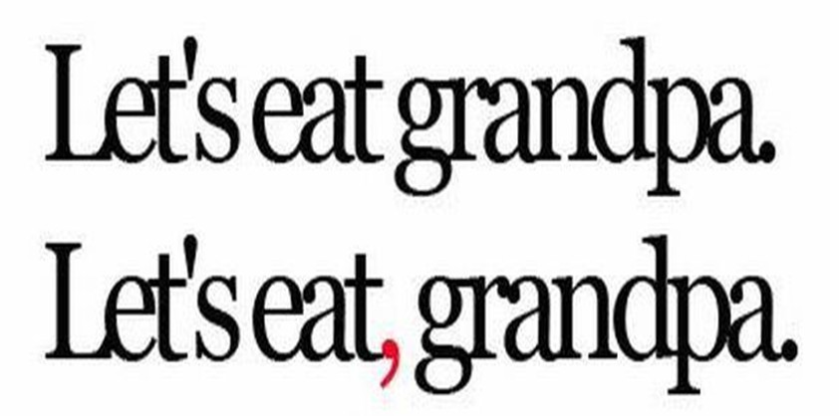
Correct punctuation can save a person’s life

Slide 5
The Power of PUNCTUATION
An English professor asked the students to punctuate the following:
“A woman without her man is nothing”
All the males in the class wrote
“A woman without her man, is nothing.”
All of the females in the class wrote
“A woman: without her, man is nothing.”

Slide 6
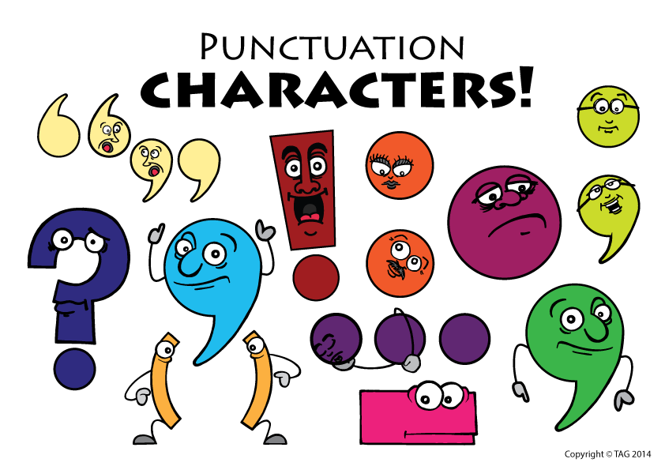
PUNCTUATION MARKS
Full stop/period(.)
Comma(,)
Colon(:)
Semi colon(;)
Question mark(?)
Exclamation mark(!)
Quotation marks(“”)
Parentheses()
Apostrophe(‘)
Hyphen and Dash(-,-)

Slide 7
Poll Question
Which of the following is not a type of punctuation?
A. comma
B. colon
C. dash
D. adjective

Slide 8

Answer
OPTION - D

Slide 9

FULL STOP
Use a full stop at the end of a complete sentence that is a statement.
Example:
I know that you would never break my trust intentionally.
A single full stop may also be used to indicate the abbreviation of commonly used words as in the following examples:
Telephone Number = Tel. No.
September = Sept.

Slide 10
Poll Question:- Choose the correct option.
My name is lucy
A. !
B. .
C. ?
D. :

Slide 11

COMMA
Commas are used to separate three or more words, phrases, or clauses in a series.
Example:
Practice will be held before school, in the afternoon, and at night.
Commas are used after an introductory dependent clause (a group of words before the subject of a sentence that do not form a complete sentence).
Example
If your friends enjoy Chinese food, they will love this restaurant.
Commas set off an appositive (a word or phrase that renames a noun).
Example
Tanya, Debbie's sister, gave a brilliant speech last night.

Slide 12
Commas are used to set off introductory words, introductory adverbial, participial, or infinitive phrases, and longer introductory prepositional phrases.
Example
Incidentally, I was not late this morning. (Word)
Hoping for a bigger fish, Rob spent three more hours fishing. (Phrase)
Commas are used between independent clauses joined by a coordinating conjunction (for, and, nor, but, or, yet , so).
Example
My dog had fleas, so we gave him a bath.
Commas set off nonessential phrases or clauses.
Example
The man, I think, had a funny laugh.

Slide 13
Poll Question
Which sentence is correct?
A. My favorite colors are pink blue and yellow.
B. My favorite colors are pink, blue, and yellow.
C. My favorite colors are , pink, blue and yellow.
D. None of the above

Slide 14
Answer
OPTION – D

Slide 15

COLON
To announce, introduce, or direct attention to a list.
Lists/series example
We covered many of the fundamentals in our writing class: grammar, punctuation, style, and voice.
Use the colon to introduce a list of items when introductory words such as
namely, for example, or that is do not appear.
Examples:
1.I want the items namely, butter, sugar, and flour.
2. I want the following items: butter, sugar, and flour.

Slide 16
Colons follow independent clauses and are used to call attention to information that comes after. Colons come after the independent clause and before the word, phrase, sentence, quotation, or list it is introducing.
Example:
Lately, I have had only one thing on my mind: graduation.
Lately, I have had one thing on my mind: graduating from college.
Lately, I have had only one thing on my mind: I can’t wait to graduate.
Lately, I have had several things on my mind: papers, grades, and finals.

Slide 17
Never use a colon after a verb that directly introduces a list.
The things on my mind are: papers, grades, and finals. ( x)
The things on my mind are the following: papers, grades, and finals.
The things on my mind are papers, grades, and finals.

Slide 18
Poll Question
Which of the following is false about COLON?
A. Use the colon to introduce a list of items when introductory words such as namely, for example do not appear.
B. Use the colon to introduce a list of items when introductory words such as namely, for example appear in the sentence.
C. Never use a colon after a verb that directly introduces a list.

Slide 19
Answer
OPTION- B

Slide 20

SEMI COLON
Use a semicolon in place of a full stop to separate two sentences. where the conjunction has been left out.
Examples:
Call me tomorrow; I will give you my answer then.
I have paid my dues; therefore, I expect all the privileges listed in the contract.
Use the semicolon to separate units of a series when one or more of the units contain commas.
Example:
This conference has people who have come from Lahore, Pakistan; Bombay, India; and Jadah, Saudi Arabia.

Slide 21
Use the semicolon between two sentences that are joined by a conjunction but already have one or more commas within the first sentence.
Examples:
When I finish here, I will be glad to help you; and that is a promise I will keep.
If she can, she will attempt that feat; and if her husband is able, he will be there to see her.

Slide 22
Poll Question
Place the semi-colon in the correct position.
I am hot I am wearing a sweater and a jacket.
A. hot;
B. wearing;
C. sweater;
D. A semi-colon is not needed.

Slide 23
Answer
OPTION- A

Slide 24

QUESTION MARK
Use a question mark only after a direct question
Example:
Will you go with me?
I asked if he would go with me
Use a question mark when a sentence is half statement and half question.
Example:
You do care, don’t you?

Slide 25
Poll Question
Which sentence is correct?
A. Is Mrs Jackson our substitute teacher today.
B. Is Mrs. Jackson our substitute teacher today?
C. Is Mrs. Jackson our substitute teacher today.

Slide 26
Answer
OPTION- B

Slide 27

EXCLAMATION MARK
An exclamation mark usually shows strong feeling, such as surprise, anger or joy. Using an exclamation mark when writing is rather like shouting or raising your voice when speaking. Exclamation marks are most commonly used in writing quoted speech. You should avoid using exclamation marks in formal writing, unless absolutely necessary.
Use an exclamation mark to indicate strong feelings or a raised voice in speech:
He exclaimed: "What a fantastic house you have!"
"Shut up!"

Slide 28
Many interjections need an exclamation mark:
"Hi! What's new?"
"Oh! When are you going?"
"Ouch! That hurt."
A non-question sentence beginning with "what" or "how" is often an exclamation and requires an exclamation mark:
What idiots we are! (We are such idiots.)
How pretty she looked in that dress! (She looked very pretty in that dress.)

Slide 29
Poll Question:- Choose the correct option.
What mark goes at the end of every exclamation?
A. ?
B. !
C. ,
D :

Slide 30
Answer
OPTION-B

Slide 31
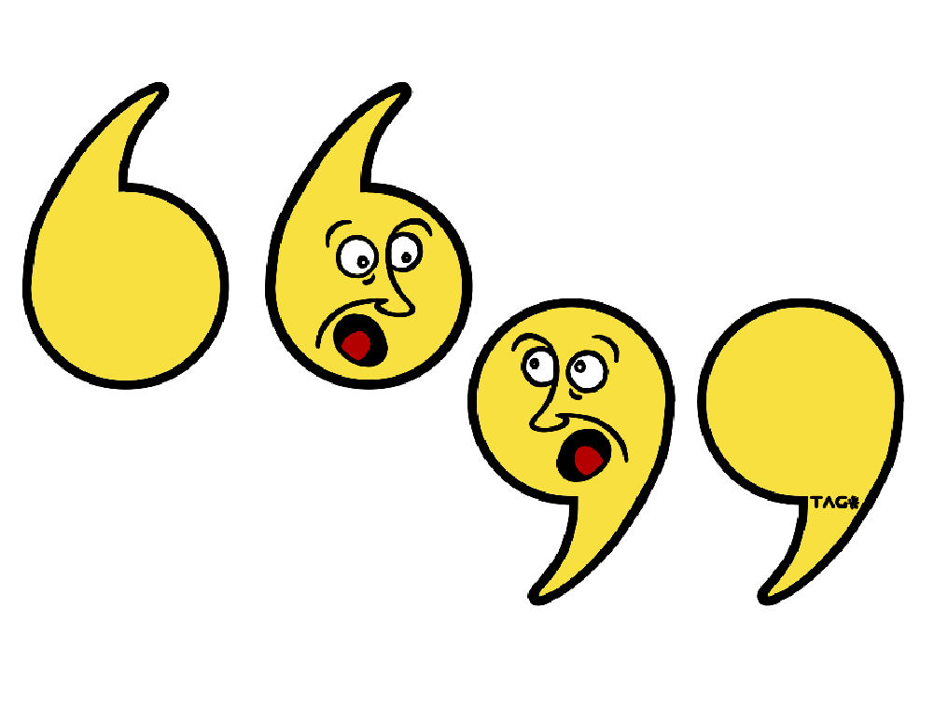
QUOTATION MARKS
Quotation marks enclose the exact words of a person.
Sia said, “I’m gonna swing from the chandelier.”
Do not use quotation marks around a paraphrase (using your own words to express the author’s ideas) or a summary of the author's words.
Example:
Megan said that Kurt’s hat was red.

Slide 32
Quotation marks set off the titles of magazine articles, poems, reports, and chapters within a book.
(Titles of books, magazines, plays, and other whole publications should be underlined or italicized.)
Example:
"The Talk of the Town" is a regular feature in Time magazine.
Place periods and commas inside quotation marks.
Pope Francis said, “I’ll have extra mayonnaise on that.”

Slide 33
Poll Question
Which sentence is correct?
A. He yelled, "I found an abandoned treehouse!“
B. "He yelled, I found an abandoned treehouse.“
C. He yelled "I found an abandoned treehouse!"

Slide 34
Answer
OPTION- A

Slide 35
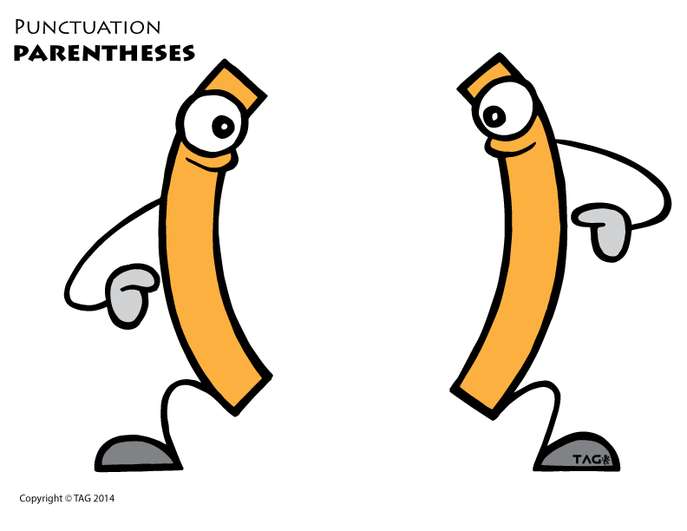
PARENTHESES
Parentheses set off additions or expressions that are not necessary to the sentence. They tend to de-emphasize what they set off.
Example:
We visited several European countries (England, France, Spain) on our trip last year.
Use full parentheses to enclose numbers or letters used for listed items.
Example:
We need an emergency physician who can (1) think quickly, (2) treat patients respectfully, and (3) handle complaints from the public.

Slide 36
When the group inside the parentheses forms a complete sentence but is inserted inside a larger sentence, no period is needed. However, if a question mark or exclamation point is needed, it should be included.
Example:
The snow (she saw it as she passed the window) was now falling heavily.
When parentheses are used to enclose an independent sentence, the end punctuation belongs inside the parentheses.
Example: Mandy told me she saw Amy’s new car. (“I saw Amy’s car before Mandy”.) She said it was a nice car.

Slide 37
Poll Question
Select the answer that has the correct use of parentheses .
A. I'll get back to you tomorrow Friday.
B. I'll get back to you tomorrow (Friday).
C. I'll get back to you (tomorrow Friday.)
D. None of the above

Slide 38
Answer
OPTION- B

Slide 39

APOSTROPHES
Apostrophes are used to show possession or to indicate where a letter has been omitted to form a contraction. To show possession, add an apostrophe and an -s to singular nouns or indefinite pronouns that end in one or body.
Example:
Susan's wrench, anyone's problem.
Add only an apostrophe for plural possessive nouns ending in -s.
Example:
My parents' car, the musicians' instruments.
Add an apostrophe and an -s for plural possessive nouns that do not end in -s.
Example:
The men's department, my children's toys

Slide 40
Add an apostrophe and an -s for singular possessive nouns that end in -s.
Example:
Chris's cookbook, the business's system.
Do not use an apostrophe with possessive personal pronouns.
yours, his, hers, its, ours, their, and whose.
Apostrophes are also used in contractions, two words which have been combined into one, to mark where the missing letter or letters would be.
Example:
I am= I’m , I have = I've who is = who's let us =let's cannot = can't he is, she is, it is = he's, she's, it is=it’s you are = you're they are = they're

Slide 41
Poll Question:- Choose the correct option
My favorite sport's are soccer and baseball.
A. correct
B. incorrect

Slide 42
Answer
OPTION-B

Slide 43
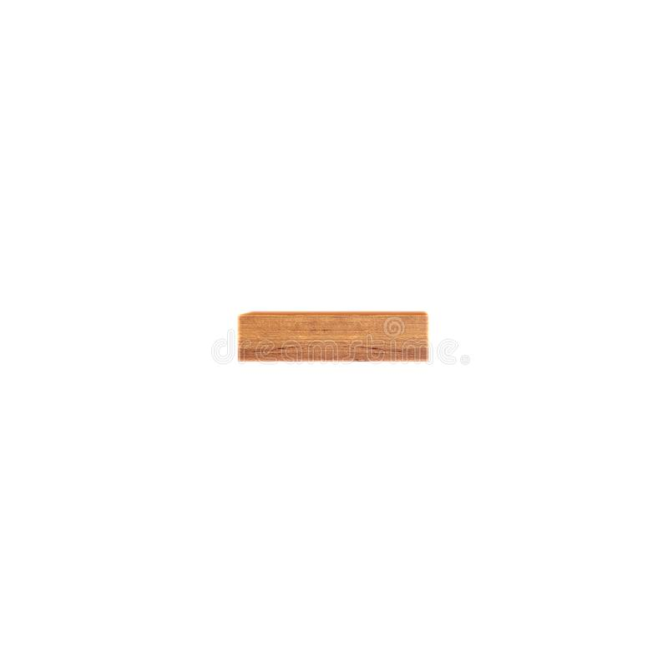
HYPHEN
Hyphens are used to form compound words or join word units. They are also used to join prefixes, suffixes, and letters to words.
Use hyphens with compound numbers from twenty-one to ninety-nine and with fractions used as modifiers (adjectives).
Example:-
forty-two students
three thousand five hundred and sixty-seven students
two-thirds majority (vs. “two thirds of the voters”)

Slide 44
Use a hyphen with the prefixes such as ex-, self-, and all-; with the suffix such as elect-; and with all prefixes before a proper noun or proper adjective.
Example:-
all-star ex-may or pro-choice self-image non-European senator-elect
Use hyphens in a compound adjective only when it comes before the word it modifies. However, some compound adjectives are always hyphenated, such as well-balanced
Example:
A well-liked author is an author who is well liked.
A world-renowned composer is a composer who is world renowned.

Slide 45
Poll Question
Please read pages 171 to 151.
If you wanted to replace the "to" with a punctuation mark, which of the below would you use?
; semicolon
B. – hyphen
C. — dash
D. None of the above.

Slide 46
Answer
OPTION- B

Slide 47

DASHES
Dashes—often confused with hyphens—connect groups of words to other groups of words to emphasize a point. Usually, the dash separates words in the middle or at the end of a sentence.
In the middle of a sentence, a dash can put special emphasis on a group of words or make them stand out from the rest of the sentence.
Example:-
Our ideas for the weekend, going to a movie, having a picnic, doing homework, and hiking Garcia Trail, seemed like a lot to squeeze in.
Our ideas for the weekend—going to a movie, having a picnic, doing homework, and hiking Garcia Trail—seemed like a lot to squeeze in.

Slide 48
The dash can also be used to attach material to the end of a sentence when there is a clear break in the continuity of the sentence or when an explanation is being introduced.
Example:
The president will be unable to win enough votes for another term of office—unless, of course, he can reduce unemployment and the deficit soon.

Slide 49
Poll Question
Which of the following is NOT a reason to use dashes?
to combine sentences
to show an abrupt interruption
to show the character's thoughts

Slide 50
Answer
OPTION A

Slide 51
“You have to practice a skill a lot to become good at it.”
THANK YOU

